Slide 1

Financial Risk Management
Spring 2016
Dr. Ehud Peleg
Heavy Tails and High Confidence Level VaR

Slide 2
Agenda
Estimating Very High Confidence Level VaRs
Exponential and Polynomial Tails
t Distribution
Power Law

Slide 3
Very High Confidence Level VaRs
Suppose I have 500 past daily returns to compute historical VaR.
How do I compute VaR_{99%}?
What about VaR_{99.8%}? VaR_{99.9%}?
I have two options for computing VaRs at very high confidence levels:
Use a parametric approach to estimate the distribution
Use a parametric approach to inflate VaR at a lower confidence level

Slide 4
Results from Historical Simulation
N=500
Scenario Number | Loss ($000s)
494 | 477.841
339 | 345.435
349 | 282.204
329 | 277.041
487 | 253.385
227 | 217.974
131 | 205.256
VaR_{99%}? VaR_{99.8%}? VaR_{99.9%}?

Slide 5
Heavy Tails
Daily exchange rate changes are not normally distributed
The distribution has heavier tails than the normal distribution
It is more peaked at the center than the normal distribution
This means that large changes are more likely than the normal distribution would suggest

Slide 6
Exponential Tail
In order to gauge how heavy is the tail of the distribution, we can look at the density function.
Consider the density of: ,
The tail of a distribution with will converge slower to 0, and therefore will have a fatter tail.

Slide 7
Mean = 0
SD = 1
VaR_{99%} = 2.33
VaR_{99%} = 2.77

Slide 8
Exponential Tail
The Normal is part of a family of distributions, with exponential rate of convergence to zero:
α is a shape parameter, θ is a scale parameter.
In case of the Normal α=2 and θ is σ.
The lower the α the heavier the tail.
All absolute moments are finite, i.e.

Slide 9
Polynomial Tail
To get heavier tails, we have to consider distributions for which the density has polynomial tails, i.e.
a is called the tail index.
The k^{th} absolute moment, i.e. , exists only if the tail index is larger than k.

Slide 10
t - Distribution
Commonly used way to model polynomial tails.
The pdf is:
ν is the degrees of freedom
It is clear that:
Hence, the tail index is ν. The weight of the tail decreases as ν increases.
It goes to the Standard Normal as ν goes to ∞.

Slide 11
t – Distribution Moments
The mean exists and equals 0 only if ν>1.
The variance exists only if ν>2, and is:
The distribution is symmetric, and its Skewness is zero.
The Kurtosis exists for ν>4, and is given by:

Slide 12
t-Distribution
The classic t-distribution has mean zero, and variance defined by ν
We can shift and scale it.
If Y has classic t-distribution with ν degrees of freedom then:
μ is the mean, λ is the scale, the variance is equal to:

Slide 14
90%-ile = $11.9
99%-ile = $30.7
99.9%-ile = $228

Slide 17
Fitting t-distribution
To fit a t-distribution, we can use MLE.
Use R:
fitt = fitdistr(X,"t")
param = as.numeric(fitt$estimate)
mean = param[1] lambda = param[2]
nu= param[3]
sd = lambda*sqrt((nu)/(nu-2))
Using MLE: ν = 2.98, λ = 7.16

Slide 18
Estimating VaR 99.9%
Is $228 a good estimator for VaR_{99.9%}?
The average daily loss/gain is roughly 0.
If we use the Normal distribution, with the sample standard deviation, σ=13.54:
If we use the MLE t-distribution estimates:

Slide 19
GARCH with t-errors
We can also fit a GARCH with t-distribution for the errors:
Where:

Slide 20
The Power Law
For many variables in practice, it is approximately true that, when X is large enough:
K and α are parameters to be estimated.
To find VaR_{1-p}:
For example:

Slide 21
Power Law – Example
Q: Suppose we know that VaR_{95%} is $10M, and α = 3, what is the probability of the loss being greater than $20M?
A:

Slide 22
Using the Power Law to Estimate Higher Confidence Level VaR
Since, VaR_{1-p}= (Κ/p)^{1/α}
If we feel more confident estimating a lower percentile, we can derive higher percentiles if we know alpha:
Q: Suppose we know that VaR_{95%}=$10M, and α = 3, what is VaR_{99%}?
A:
Compare to Normal:

Slide 23
Expected Shortfall for Power Law
Power Law:
CDF of X:
PDF of X:
Let d=VaR_{1-p}
Conditional PDF:
The lower the alpha, the higher the ratio ES/VaR.

Slide 24
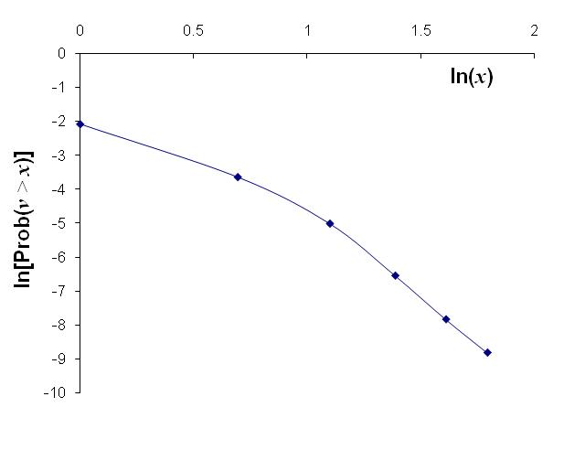
Log-Log Plot for Estimating Power Law
Far enough in the tail, we can run a regression to find K and α:
Ln[Prob(v > x)] = lnK - αlnx

Slide 25
Estimating Power Law
Suppose daily returns for S&P are given in SPreturn array, with length n:
x=sort(SPreturn) #Sort the returns
m=100 #Consider the first 100, i.e. greatest losses
xx=log(-x[1:m]) #Take log of absolute value of losses
yy=log((1:m)/n) #yy[i] is the log of the portion of losses greater than xx[i]
fit =lm(yy~xx) #Estimate the regression
paste(“slope = “, fit$coef[2])

Slide 26
Ln[Prob(v > x)] = lnK - αlnx
slope = -1.916
intercept = 2.354
α = 1.916
K=10.525
VaR_{1-p}= (Κ/p)^{1/α}
VaR_{99%}= 37.79
VaR_{99.9%}= 126
Highest 100 losses used for estimation

Slide 27
Hill’s Alpha
An estimator for alpha.
We can use a conditional sample average as an estimator of the conditional expectation.
Conditional distribution:
Integration by parts:

Slide 28
Hill’s Alpha (cont.)
Select a high loss level, d. Consider all the losses that are greater than d. Suppose there are n(d) such losses, call them x_{(i)} then:
Extend code to estimate using largest 100 losses: recall: x=sort(SPreturn) and m=100
hill.alpha = m/sum(log(x[1:m]/x[m])

Slide 30
Hill Estimates based on different cutoffs (d) for 1000 S&P Daily Returns

Slide 31
Thanks

